Slide 1
Machine learning in epidemiology studies
A case study of extreme longevity prediction
Dor Atias, MD

Slide 2

DISCLAIMER
שלום לכם אפידמיולוגים,
אנחנו שמחים שבאתם.
עוד מעט תראו,
ממצאים שכבר למדתם.

Slide 3
Objectives
What is ML?
Know your tools
Case study with real life results
Oh, and a word on centenarianism

Slide 4

Machine learning in epidemilogy

Slide 5
“the field of study that gives computers the ability to learn without being explicitly programmed”
Arthur Samuel

Slide 6
Background
The ever-growing data in healthcare
New challenge arise
Personalized medicine
Technological advancements
Machine learning

Slide 7
Key differences
Traditional statistics
Inference and hypothesis testing
Rely on explicit assumptions about the underlying data distribution
Machine learning
Prediction and pattern recognition
Can handle complex and unstructured data without strict assumptions
Easy to Interpret
"Black box"

Slide 8
Modeling proccess
Problem Definition
Data Collection
Data Preprocessing
Exploratory Data Analysis
Feature Selection
Model Selection
Model Training
Model Evaluation
Interpretation and Validation
Deployment and Monitoring

Slide 9
Prediction of Extreme Longevity in a Population-Based Cohort
A comparison between machine learning and classical epidemiological methods

Slide 10
Problem Definition
Apply ML methodologies and contrast them with classic epidemiological methods, to assess a variety of potential indicators of exceptional longevity in a cohort of middle-aged working males followed to their end of life.
Problem Definition
Data Collection
Data Preprocessing
Exploratory Data Analysis
Feature Selection
Model Selection
Model Training
Model Evaluation
Interpretation and Validation
Deployment and Monitoring
Notes:
Clearly define the research question or problem you want to address
predicting disease outcomes
Clustering patients into subgroups
Etc.

Slide 11
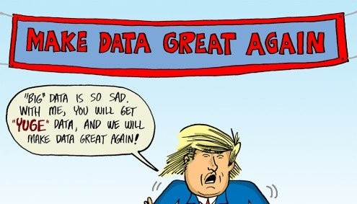
Data Collection
Volume
Velocity
Variety
Problem Definition
Data Collection
Data Preprocessing
Exploratory Data Analysis
Feature Selection
Model Selection
Model Training
Model Evaluation
Interpretation and Validation
Deployment and Monitoring
Notes:
Volume: Big data involves large volumes of data, typically ranging from terabytes to petabytes and beyond. This data may come from various sources such as sensors, social media, transaction records, scientific experiments, and surveillance systems.
Velocity: Big data is generated at a high velocity and accumulates rapidly over time. The data streams in continuously and must be processed in near real-time to extract actionable insights. Examples of high-velocity data sources include social media updates, website clicks, and sensor data from Internet of Things (IoT) devices.
Variety: Big data comes in diverse formats and structures, including structured data (e.g., databases, spreadsheets), unstructured data (e.g., text, images, videos), and semi-structured data (e.g., XML, JSON). It may also include streaming data, geospatial data, time-series data, and graph data.

Slide 12
Cohort
The Israeli Ischemic Heart Disease (IIHD) project
Prospective cohort study of civil servants and municipal employees recruited in the 1963 (n = 10,059) aged 40-65 (mean, 49 years)
Underwent an extensive and multifaceted assessment of physical, social, and mental well-being in 1963, 1965, and 1968
Followed up for mortality through 2019
692 (6.9%) participants reached the age of 95 years or older.
Problem Definition
Data Collection
Data Preprocessing
Exploratory Data Analysis
Feature Selection
Model Selection
Model Training
Model Evaluation
Interpretation and Validation
Deployment and Monitoring

Slide 13
Data Preprocessing
Clean the data
Process the data
Create new data
Missing values
Outliers
Inconsistencies
Imputation
Normalization
Scaling
Encoding categorical variables
Feature engineering to extract relevant features from the data.
Problem Definition
Data Collection
Data Preprocessing
Exploratory Data Analysis
Feature Selection
Model Selection
Model Training
Model Evaluation
Interpretation and Validation
Deployment and Monitoring

Slide 14
Data Preprocessing
505 variables
In the raw dataset
287 variables
Remained after removing duplicate, follow-up outcome variables after and administrative variables
Follow up variables
Continuous measurements were summarized
Disease indicators
Smoking status change
Missing data
12 variables with more than 15% missing data
136 variables were considered for the final model
1 identification, 33 demographics, 41 medical, 3 physical activity, 23 work-related data, 11 family relations, and 23 diet.
Outcome binary indicator of reaching the age of 95 and beyond.
Problem Definition
Data Collection
Data Preprocessing
Exploratory Data Analysis
Feature Selection
Model Selection
Model Training
Model Evaluation
Interpretation and Validation
Deployment and Monitoring
Notes:
Created in the 1960s and moved many hands
Resulted in 500+ variables – some duplicated some new
MESS!
Needs cleaning

Slide 15

Exploratory Data Analysis
Problem Definition
Data Collection
Data Preprocessing
Exploratory Data Analysis
Feature Selection
Model Selection
Model Training
Model Evaluation
Interpretation and Validation
Deployment and Monitoring
Notes:
Explore the dataset to understand its characteristics, distributions, correlations, and potential patterns.
Visualization techniques such as histograms, scatter plots, box plots, and correlation matrices can help in this step

Slide 16
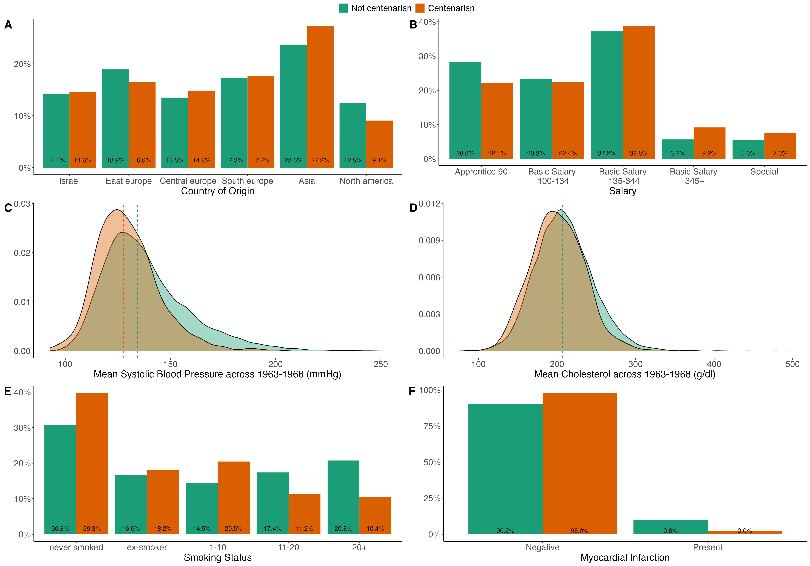
Exploratory Data Analysis
Problem Definition
Data Collection
Data Preprocessing
Exploratory Data Analysis
Feature Selection
Model Selection
Model Training
Model Evaluation
Interpretation and Validation
Deployment and Monitoring
Notes:
Explore the dataset to understand its characteristics, distributions, correlations, and potential patterns.
Visualization techniques such as histograms, scatter plots, box plots, and correlation matrices can help in this step

Slide 17
Feature Selection
Mostly done by model architecture (e.g., Lasso regularization)
Dimensionality reduction techniques like principal component analysis (PCA) or t-distributed stochastic neighbor embedding (t-SNE)
Problem Definition
Data Collection
Data Preprocessing
Exploratory Data Analysis
Feature Selection
Model Selection
Model Training
Model Evaluation
Interpretation and Validation
Deployment and Monitoring

Slide 18
Model Selection
Choose the appropriate model
Nature of the problem
Characteristics of the data.
Common models
logistic regression, decision trees, random forests, support vector machines, gradient boosting machines, and neural networks.
Trade-offs
model complexity
interpretability
performance.
Problem Definition
Data Collection
Data Preprocessing
Exploratory Data Analysis
Feature Selection
Model Selection
Model Training
Model Evaluation
Interpretation and Validation
Deployment and Monitoring

Slide 19

Types of models
Problem Definition
Data Collection
Data Preprocessing
Exploratory Data Analysis
Feature Selection
Model Selection
Model Training
Model Evaluation
Interpretation and Validation
Deployment and Monitoring
Notes:
(1) Supervised algorithms use labeled data, i.e. data with known outcomes, to train models for prediction tasks, such as diagnosing diseases or forecasting patient outcomes; while (2) unsupervised algorithms takes data with no labels and find hidden structures and relationships within the data

Slide 20
Logistic regression
Maximazing the likelihhod function
Assuming linear relationship between the independent variables and the log-odds of the positive class
Researcher's involvement is needed for variables selection and interactions
Cannot handle missing data
Not suitable when the number of predictors exceeds the number of observations (p > N)
Highly interpretable
Problem Definition
Data Collection
Data Preprocessing
Exploratory Data Analysis
Feature Selection
Model Selection
Model Training
Model Evaluation
Interpretation and Validation
Deployment and Monitoring

Slide 21
Least Absolute Shrinkage and Selection Operator
Similar to logistic regression
Introduces a regularization term to penalize the magnitude of the coefficients.
Hyperparameter λ controls the amount of regularization
Automatic feature selection
Can handle large datasets and many features (p>N).
Problem Definition
Data Collection
Data Preprocessing
Exploratory Data Analysis
Feature Selection
Model Selection
Model Training
Model Evaluation
Interpretation and Validation
Deployment and Monitoring
Notes:
where:
Cost is the cost function measuring the difference between the predicted probabilities and the actual labels
m is the number of instances in the training data.
n is the number of features.
Βj is the coefficient associated with the j-th feature.
λ is the regularization parameter.
The optimization problem is to minimize this cost function with respect to the coefficients
β
β, balancing between fitting the data and penalizing large coefficient values.
The hyperparameter λ controls the amount of regularization and is typically tuned using techniques like cross-validation to find the optimal balance between model complexity and performance.
One of the key advantages of LASSO classification is its ability to perform automatic feature selection by shrinking some coefficients to zero. Features with zero coefficients are effectively excluded from the model, simplifying interpretation and potentially improving generalization performance by reducing overfitting.

Slide 22

Decision trees
Problem Definition
Data Collection
Data Preprocessing
Exploratory Data Analysis
Feature Selection
Model Selection
Model Training
Model Evaluation
Interpretation and Validation
Deployment and Monitoring
Notes:
A decision tree is a hierarchical structure consisting of nodes, branches, and leaves.
Each internal node represents a decision based on the value of a feature, leading to different branches.
Each leaf node represents a predicted outcome (class label in classification or numerical value in regression).
Decision trees make decisions by recursively splitting the dataset based on the values of the features.
At each internal node, the algorithm selects the feature and the corresponding split point that best separates the data into homogeneous subsets, typically aiming to maximize information gain or minimize impurity.
The process continues recursively until a stopping criterion is met, such as reaching a maximum depth, minimum number of samples per leaf, or minimum decrease in impurity.
The choice of the feature and split point at each node is determined by a splitting criterion, which measures the homogeneity of the subsets created by the split.
Common splitting criteria for classification include Gini impurity and entropy, which quantify the uncertainty or disorder in the dataset.
For regression tasks, the mean squared error (MSE) or mean absolute error (MAE) is often used as the splitting criterion.

Slide 23
eXtreme Gradient Boosting
XGBoost optimize the loss function and the regularization term.
Boosting - ensemble of decision trees sequentially, each decision tree is trained to correct the errors made by the previous trees
Variables selection and interactions are built into the tree architecture
Can handle missing data
Can handle large datasets, many features (p>N) and complex relationships.
Low interpretability, ad hoc methods for explanation are needed.
Problem Definition
Data Collection
Data Preprocessing
Exploratory Data Analysis
Feature Selection
Model Selection
Model Training
Model Evaluation
Interpretation and Validation
Deployment and Monitoring
Notes:
Gradient Boosting
XGBoost builds an ensemble of decision trees sequentially. Each decision tree is trained to correct the errors made by the previous trees.
At each iteration, the model fits a new tree to the residuals (the differences between the actual and predicted values) of the previous predictions.
the final prediction is made by aggregating the predictions of all the trees in the ensemble.
Regularization:
XGBoost incorporates regularization techniques to prevent overfitting and improve generalization performance. It includes parameters for controlling the complexity of individual trees and the overall model.
Regularization parameters in XGBoost include max_depth (maximum depth of each tree), min_child_weight (minimum sum of instance weight required in a child), gamma (minimum loss reduction required to make a further partition on a leaf node), and lambda (L2 regularization term on weights).

Slide 24


Model Training
Each dataset was randomly divided into train and test subsets (75%/25%)
Models’ hyperparameters were tuned via a grid search on a 10-fold cross-validation
All analyses and visualizations were carried out using R version 4.3.2 and are accessible on GitHub
Problem Definition
Data Collection
Data Preprocessing
Exploratory Data Analysis
Feature Selection
Model Selection
Model Training
Model Evaluation
Interpretation and Validation
Deployment and Monitoring

Slide 25
Model Evaluation
Discrimination
Calibration
Problem Definition
Data Collection
Data Preprocessing
Exploratory Data Analysis
Feature Selection
Model Selection
Model Training
Model Evaluation
Interpretation and Validation
Deployment and Monitoring
All evaluations were measured on the test set
Notes:
Evaluate the performance of the trained models using appropriate evaluation metrics relevant to the specific epidemiological problem.
Common evaluation metrics include accuracy, precision, recall, F1-score, area under the receiver operating characteristic curve (AUC-ROC), etc.
Assess the model's generalization ability on the validation and test sets to ensure it can perform well on unseen data.
לבחינת ביצועי המודל בחרנו שני קריטריונים
דיסקרימינציה – היכולת להפריד בין הקבוצות (משתמש ממושך ומשתמש לא ממשוך)
קרליברציה – עד כמה ההסתברות שניתנה לנבדק מייצגת את הסיכון האמיתי שלו

Slide 26
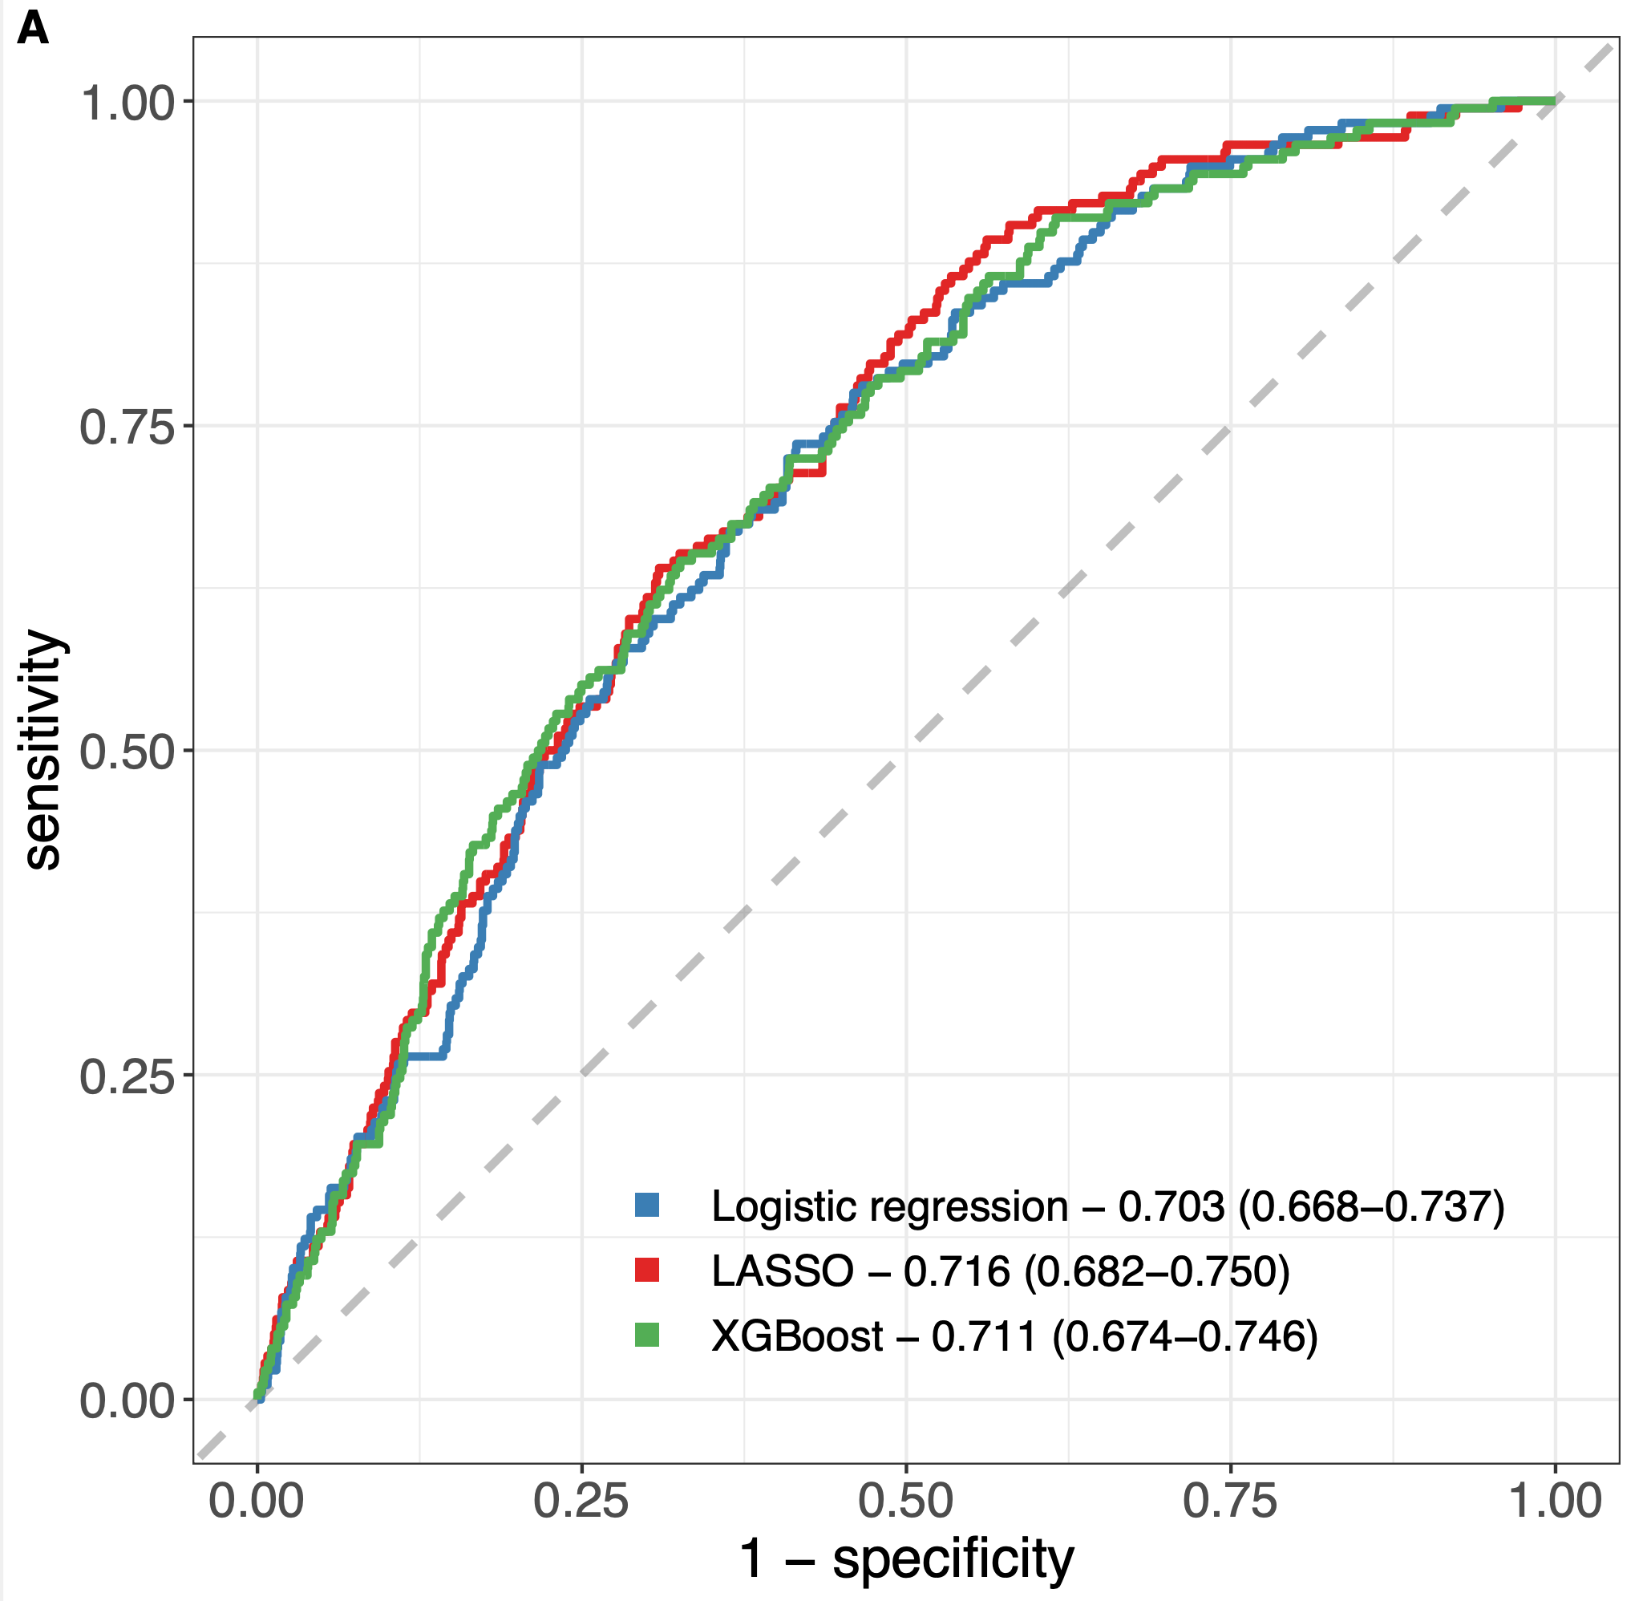
Discriminative performances
Sensitivity, Specificity, and ROC-AUC
Classification threshold value choice
All metrics’ 95% CI were calculated using the percentile bootstrap method with 1,000 samples
Problem Definition
Data Collection
Data Preprocessing
Exploratory Data Analysis
Feature Selection
Model Selection
Model Training
Model Evaluation
Interpretation and Validation
Deployment and Monitoring
Notes:
לגבי הYouden's J, בעצם הפרמטר הזה משקלל רגישות וסגוליות (רגישות+סגוליות-1) ונותן את נקודת הקלסיפיקציה עם הערך המקסימלי של שניהם. 1 מושלם 0 גרוע (כמו הטלת מטבע).
חישוב CI בעזרת percentile bootstrap זו בעצם שיטה א-פרמטרית שלא מניחה הנחות על התפלגות הפרטמר באוכלוסיה שבה אנחנו דוגמים עם החזרה מהדאטה ומחשבים את הפרטמר X פעמים, למדגם הזה שיצא אנחנו לוקחים את את האחוזון ה2.5 וה97.5 כדי לחשב CI
sensitivity, specificity, and the area under the receiver operating characteristic curve (ROC-AUC) on the test set
Youden's J statistic (also called Youden's index) is a single statistic that captures the performance of a dichotomous diagnostic test. SENS + SPEC -1. it ranges between -1 to 1 where 1 is great and 0 is useless. `Youden's index is often used in conjunction with receiver operating characteristic (ROC) analysis.[3] The index is defined for all points of an ROC curve, and the maximum value of the index may be used as a criterion for selecting the optimum cut-off point when a diagnostic test gives a numeric rather than a dichotomous result.
The percentile bootstrap is a nonparametric method based on data-driven simulations. Assessing population parameter using only the data at hand, without making assumptions about underlying distributions. Sampling with return X times and taking the quantiles to infer CI

Slide 27
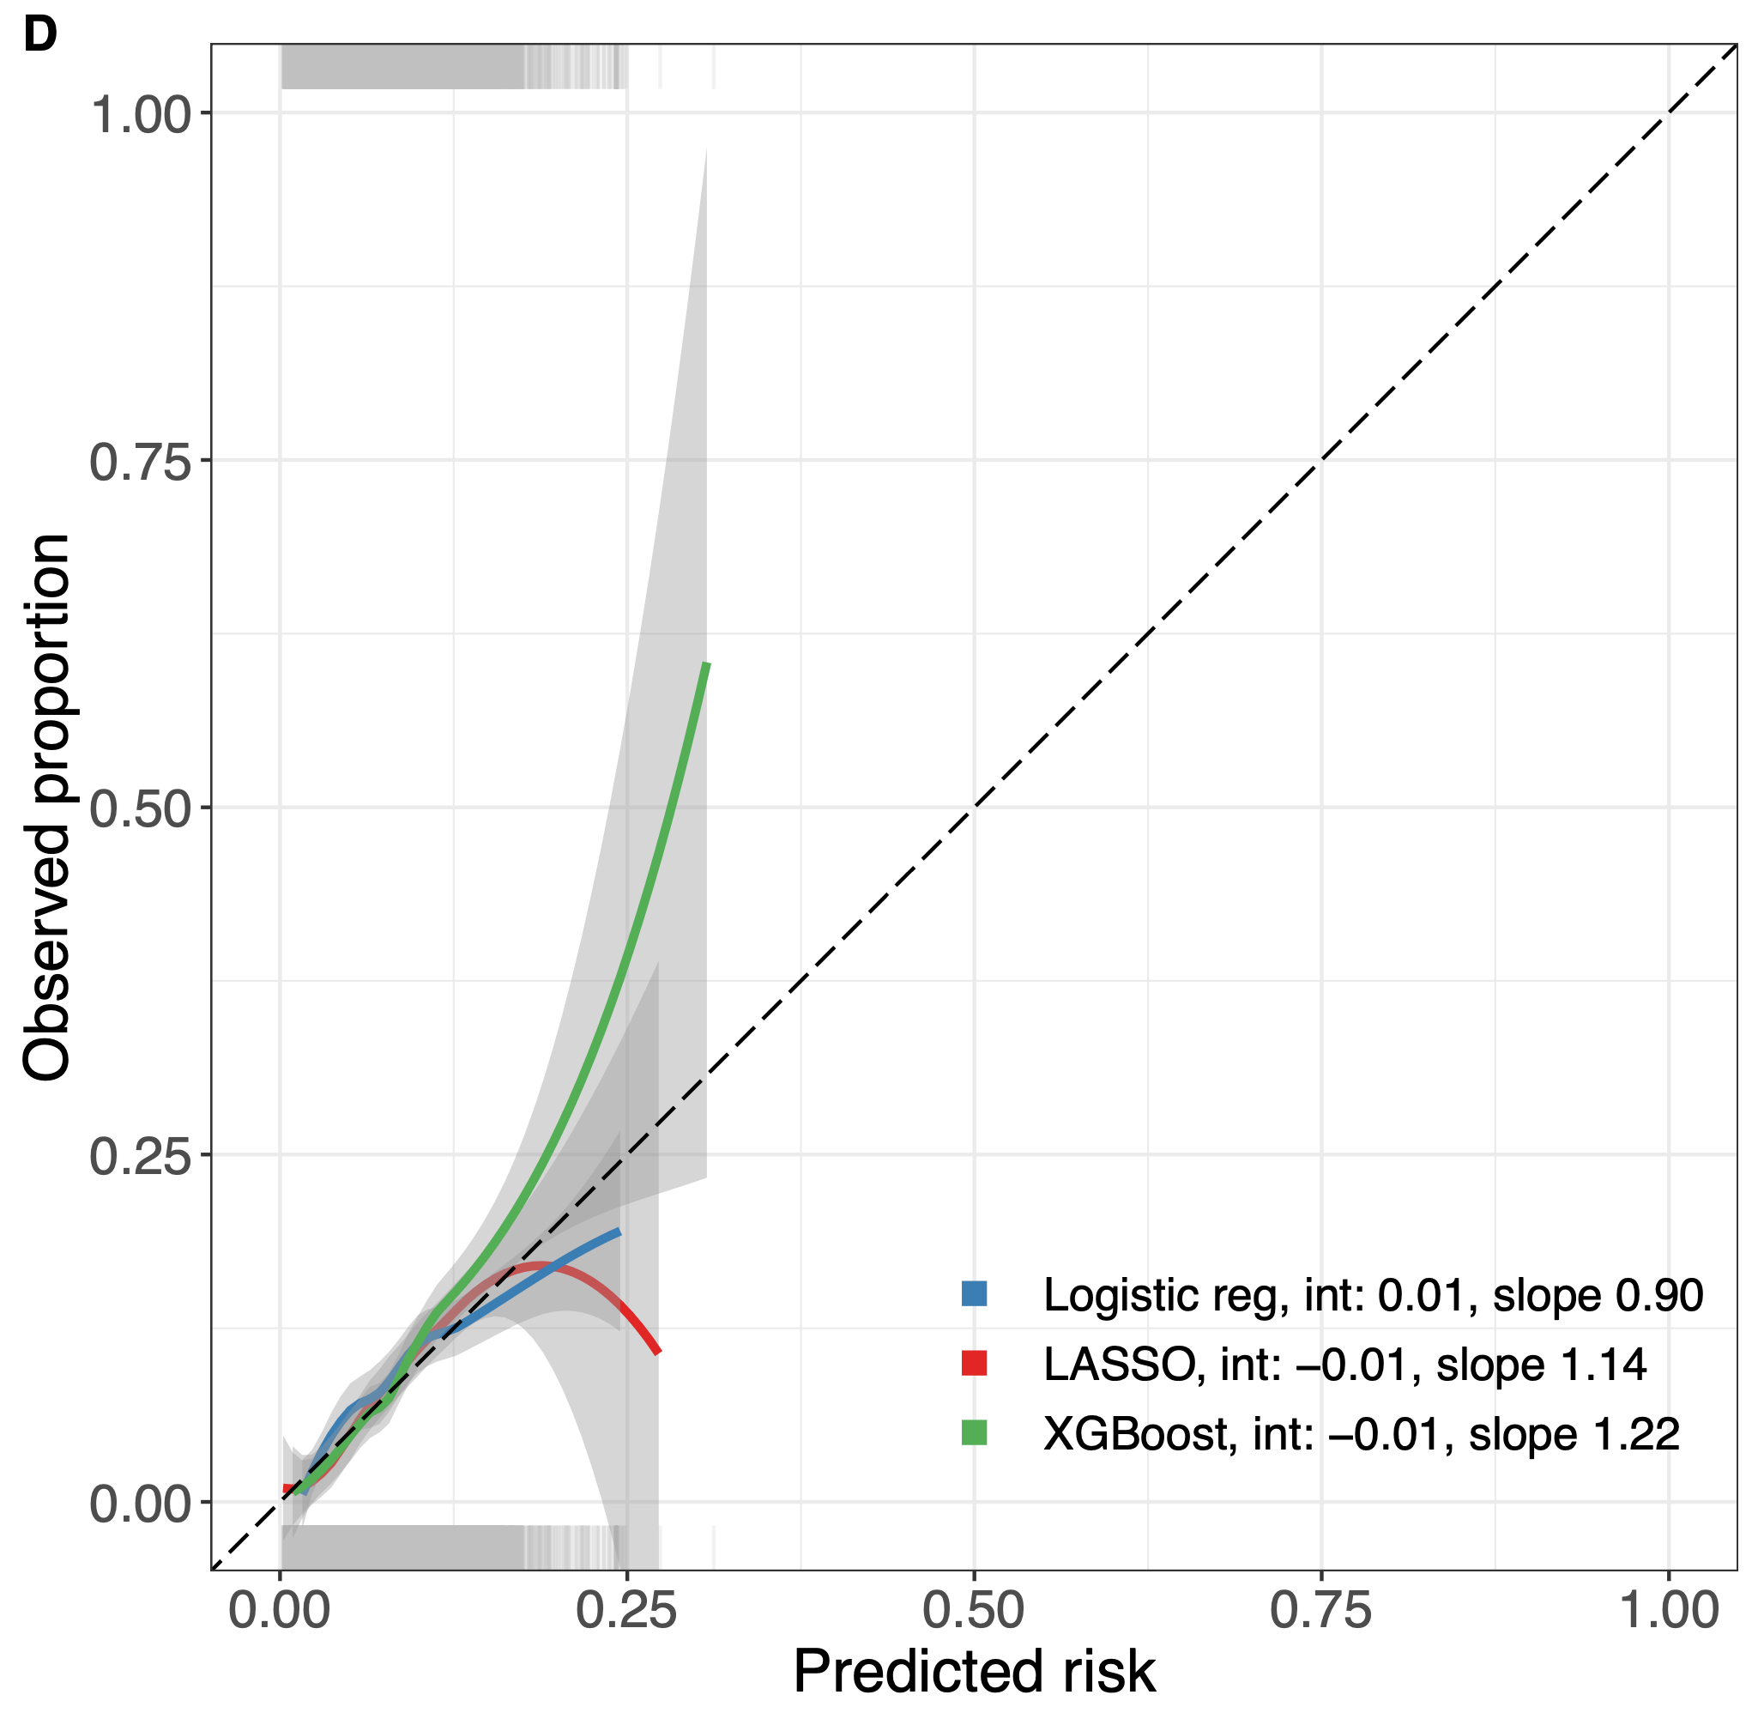
Calibration performances
Model output were calibrated using logistic generalized additive model constrained to be monotonically increasing
Calibration was examined through calibration plot
Problem Definition
Data Collection
Data Preprocessing
Exploratory Data Analysis
Feature Selection
Model Selection
Model Training
Model Evaluation
Interpretation and Validation
Deployment and Monitoring
Notes:
מודלים פרובביליסטיים ממקסמים את פונקציית ההסתברות, מכיוון שהמודל שלנו אומן למקסם את ההפרדה בין הקבוצות, פלט המודל מהווה מספר בין 0-1 אך אינו מייצג נכונה את ההתסברות – לכן ביצענו כיוונון של הפלט שייצג הסתברות.
ביצוע הכיול היה באמצעות GAM שהוכרח להיות עולה בצורה מונוטנית כדי להיות גמיש מצד אחד אבל מצד שני למנוע אובר פיטינג לטרייניג?
לאחר מכן בחינת הקליברציה נעשתה באמצעות עקומת קליברציה
על ציר האיקס - ההסתברות החזויה
על ציר הוואי - הפרופורציה הנצפית של התוצא בקרב אנשים עם הסתברות דומה
שרטוט של ממוצע נע / מוחלק של התצפיות
קו אלכסוני מהווה קליברציה מושלמת (כל אלו שנחזה להם סיכוי של 0.25 גם יש להם פרופורציה של 0.25)
קו מעל המגמה הערכת חסר (ניתן חיזוי של 0.25 ובפועל יש 0.375)
מעריכים בשתי שיטות
ויזואלית – מסתכלים על קו המגמה
מודל רגרסיה לוגיסטית בין ההסתברות החזוי ללוג אודס: חותך של 0 ושיפוע של 1
To calibrate the XGBoost output
We then examined calibration through a logistic regression model between the prediction and the observed outcome, where a perfect calibration should yield a model with an intercept of 0 and a slope of1
Calibration plot – line above the dotted line is underestimating
All further analyses based on model 1
1

Slide 28
Interpretation and Validation
Interpret the trained models
Validate the findings against existing knowledge
Problem Definition
Data Collection
Data Preprocessing
Exploratory Data Analysis
Feature Selection
Model Selection
Model Training
Model Evaluation
Interpretation and Validation
Deployment and Monitoring
Notes:
Interpret the trained models to gain insights into the relationships between features and outcomes in the epidemiological context.
Validate the findings against existing knowledge or clinical expertise to ensure their validity and relevance.

Slide 29

Model explanation
”black box”
SHapley Additive exPlanations (SHAP) values
post-hoc explanation method of a model’s predictions
SHAP values were computed using kernel SHAP on post-calibration models
Problem Definition
Data Collection
Data Preprocessing
Exploratory Data Analysis
Feature Selection
Model Selection
Model Training
Model Evaluation
Interpretation and Validation
Deployment and Monitoring
Notes:
המודל, בניגוד לרגרסיה לוגיסטית אשר ההחלטות חשופות בפנינו בצורת משתנים, אינו מגלה לנו למה ביצע את ההחלטה ״קופסא שחורה״
שאפ היא צורה לפתוח את הקופסא בעצם להסביר את המודל לאחר יצירתו
השיטה לוקחת את הדאטה, בכל פעם בוחרת משתנה אחרת ויוצרת הרבה פרמוטציות של תצפיות ובעצם השינוי במשתנים האחרים מחשבת מה הייתה התרומה של המשתנה שהיא בחנה. בעזרת השיטה אפשר לייצר הסבר גלובלי ולוקלי.
Asses different variable at a time by creating random permutations – can explain globally or locally
Give an example on UTI AB resisntans

Slide 30
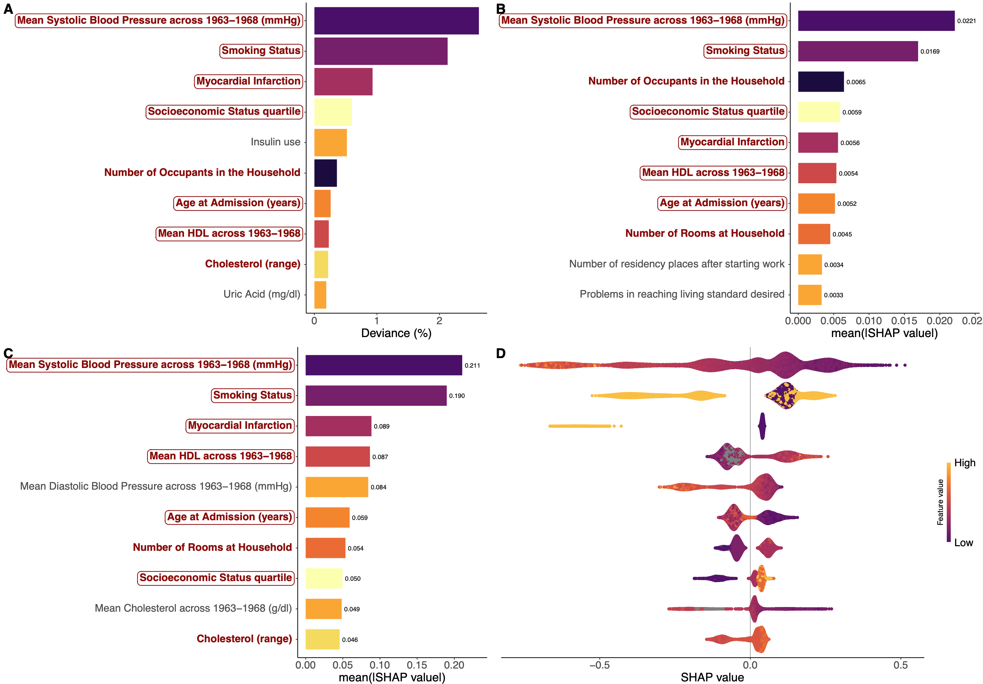
Model explanation
Problem Definition
Data Collection
Data Preprocessing
Exploratory Data Analysis
Feature Selection
Model Selection
Model Training
Model Evaluation
Interpretation and Validation
Deployment and Monitoring

Slide 31
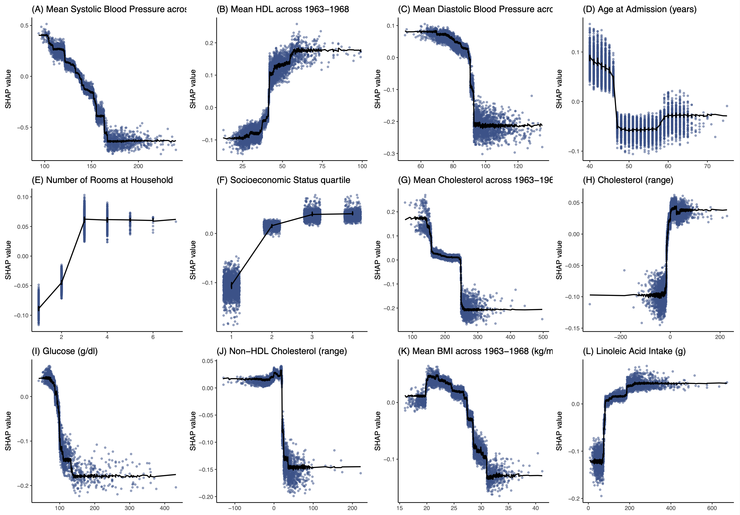
Model explanation
Problem Definition
Data Collection
Data Preprocessing
Exploratory Data Analysis
Feature Selection
Model Selection
Model Training
Model Evaluation
Interpretation and Validation
Deployment and Monitoring

Slide 32
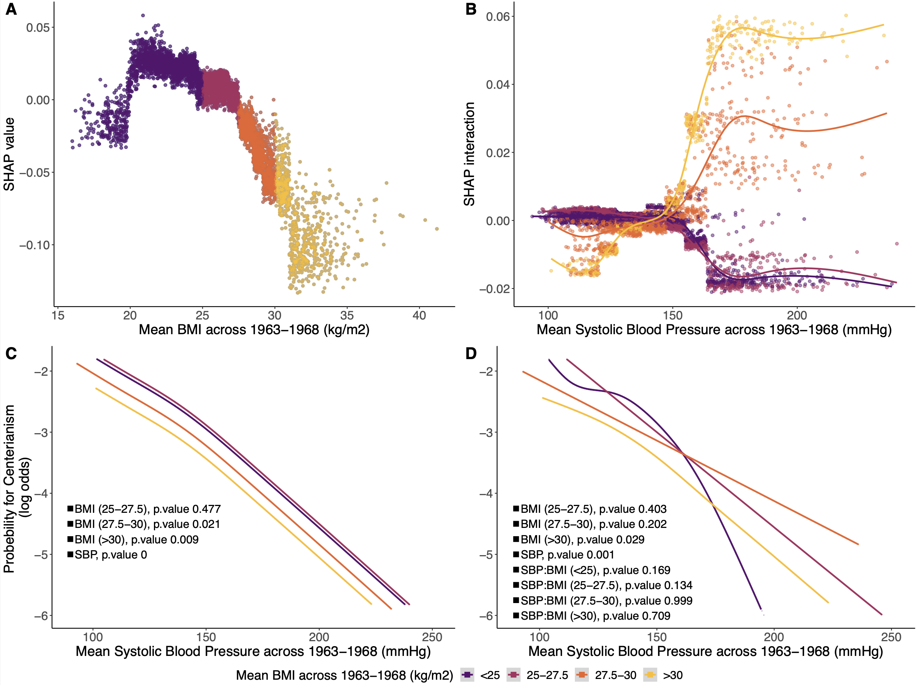
Model explanation
Problem Definition
Data Collection
Data Preprocessing
Exploratory Data Analysis
Feature Selection
Model Selection
Model Training
Model Evaluation
Interpretation and Validation
Deployment and Monitoring

Slide 33
Deployment and Monitoring
Deploy the trained model in real-world settings
Publish the models results
Continuously monitor and update the model as new data becomes available or as the epidemiological landscape evolves.
Problem Definition
Data Collection
Data Preprocessing
Exploratory Data Analysis
Feature Selection
Model Selection
Model Training
Model Evaluation
Interpretation and Validation
Deployment and Monitoring

Slide 34

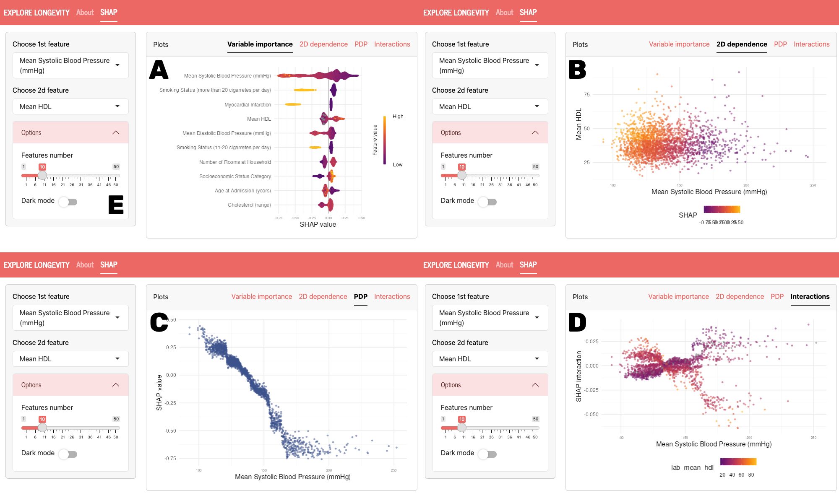
Deployment and Monitoring
Problem Definition
Data Collection
Data Preprocessing
Exploratory Data Analysis
Feature Selection
Model Selection
Model Training
Model Evaluation
Interpretation and Validation
Deployment and Monitoring

Slide 35
So, is there such a thing?

Slide 36
Take home message
Enhanced Prediction Accuracy
Population-Level Insights
Ethical Considerations
Feature Selection and flexibility
Interpretability
Data related challenges
Notes:
Enhanced Prediction Accuracy: Machine learning techniques can significantly improve the accuracy of predicting disease outbreaks, identifying risk factors, and understanding disease progression by analyzing large and complex datasets more effectively than traditional statistical methods.
Feature Selection and Interpretability: Proper feature selection and interpretability of machine learning models are crucial in epidemiology to ensure that the identified associations are meaningful and actionable for public health interventions.
Population-Level Insights: Machine learning enables the analysis of diverse data sources, including demographic, environmental, and socioeconomic factors, to uncover population-level insights into disease risk and transmission dynamics, informing targeted intervention strategies and policy decisions.
Challenges and Ethical Considerations: Despite their potential benefits, the use of machine learning in epidemiology poses challenges related to data quality, model validation, and ethical considerations such as privacy preservation and algorithmic bias, highlighting the importance of interdisciplinary collaboration and ethical oversight in research and implementation.

Slide 37

Questions?

